Slide 1
Last day of class!

Slide 2
Announcements
Final project due Thurs!
Please complete the SPOT scores (6/8!) One more for + points.
Bad ggplots today

Slide 3
Why do we do this?
Failure is central to academia and laughing and acknowledging our failures along the way helps us grow (and detoxifies success culture)

Slide 4

Ways to grow from (or at least not be devastated by) failure
Be honest
Be thankful
Take Responsibility
Learn from it
Move on
From: McCardle ‘The Up Side of Down: Why Failing Well is the Key to Success’

Slide 5
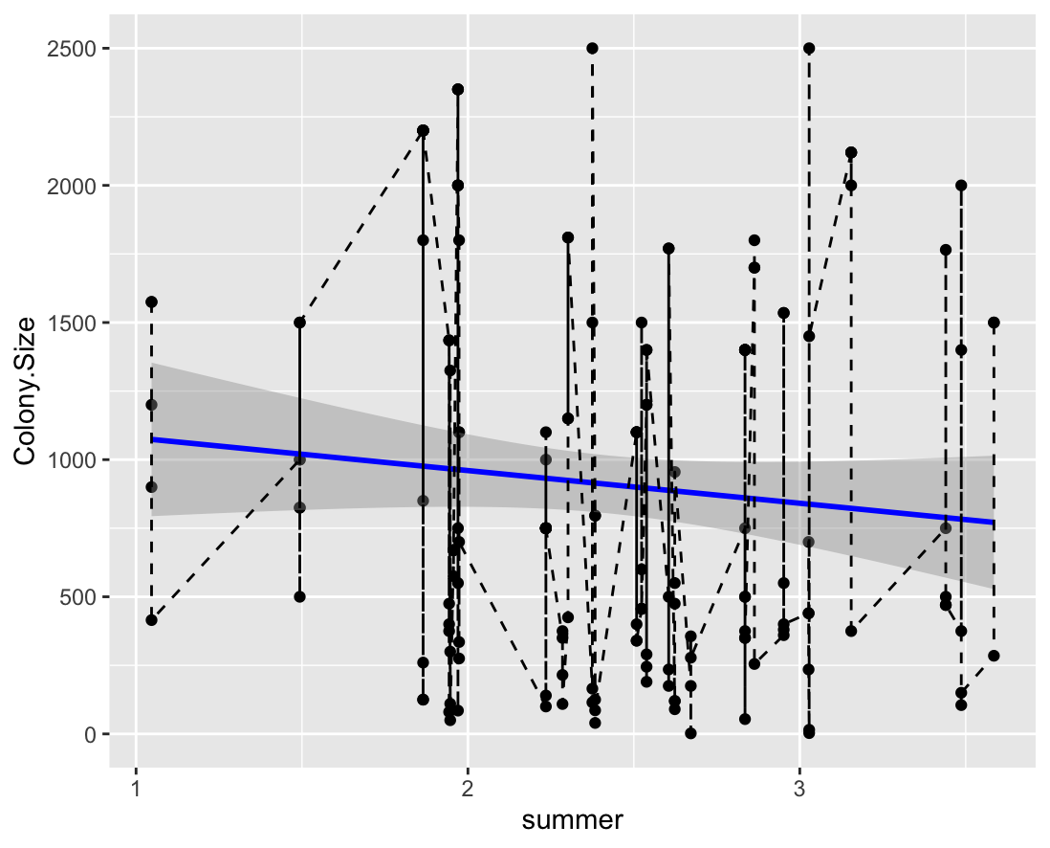
#1

Slide 6
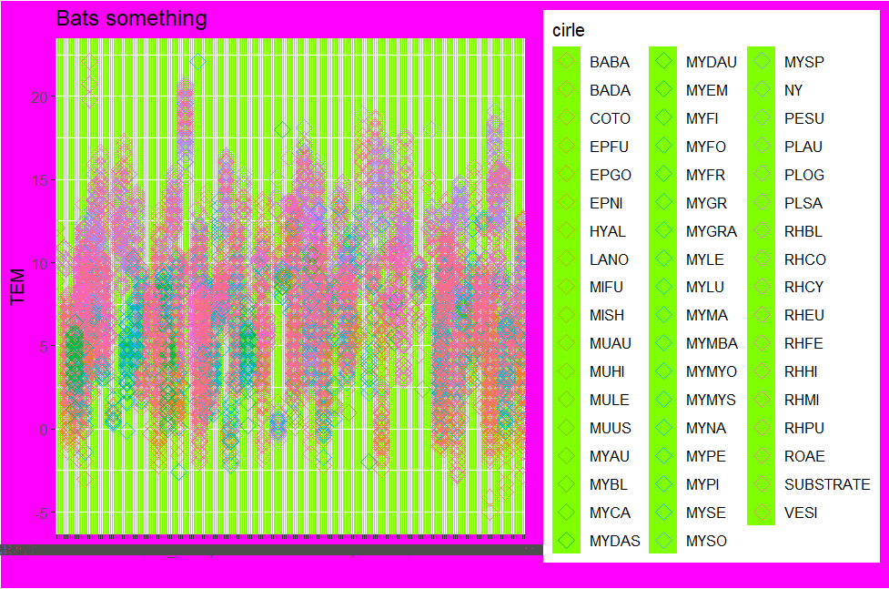
#2
Notes:
WINNER (Tyler)

Slide 7
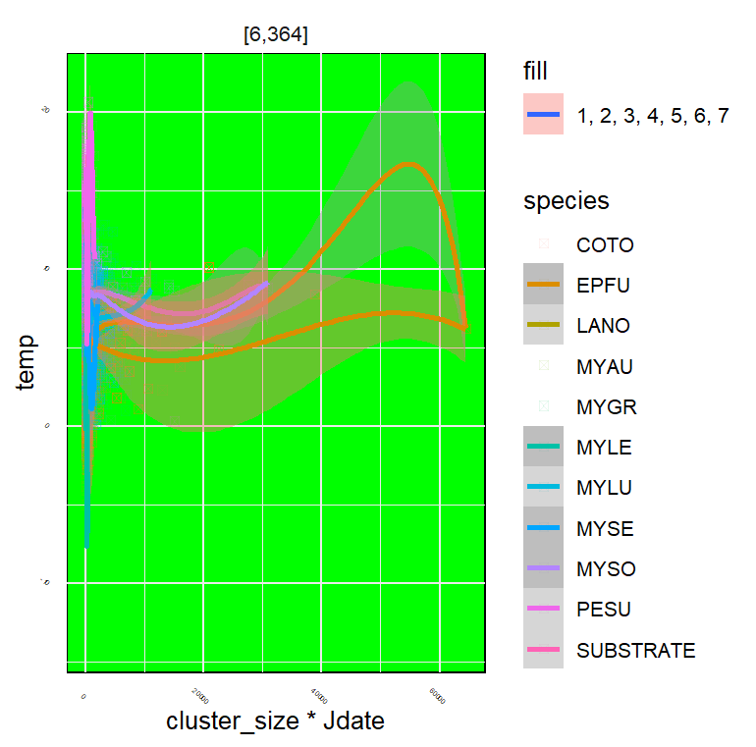
#3
Notes:
WINNER (MAYA)

Slide 8
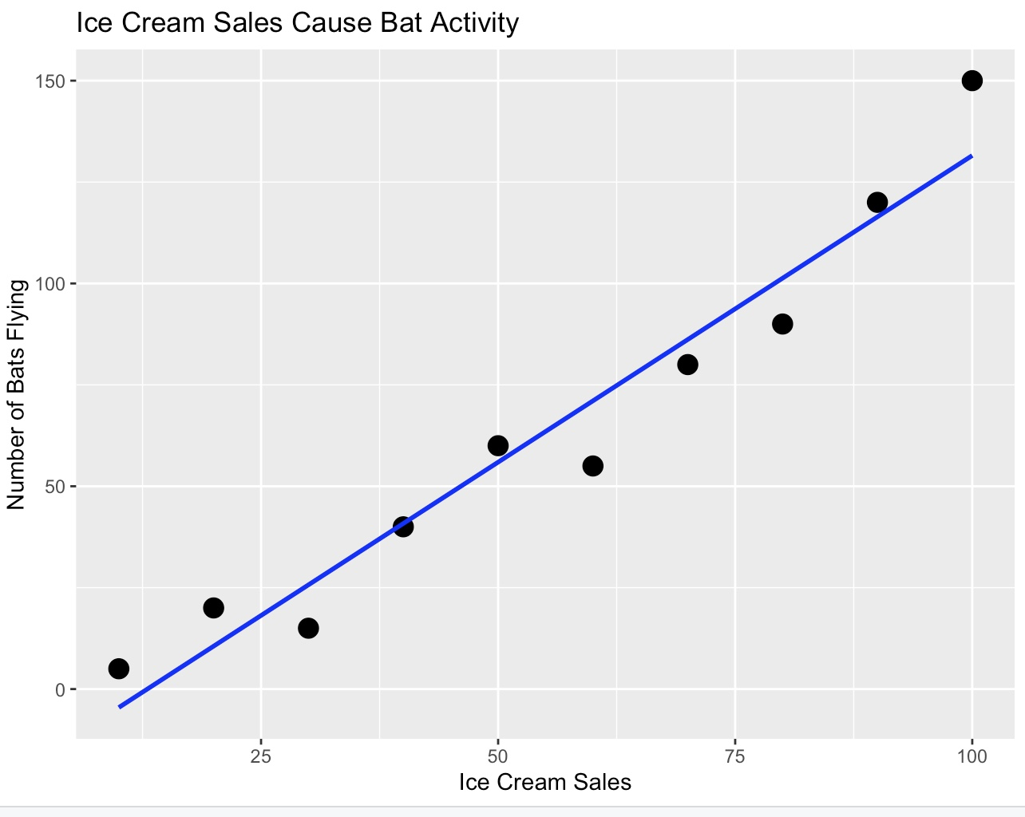
#4

Slide 9
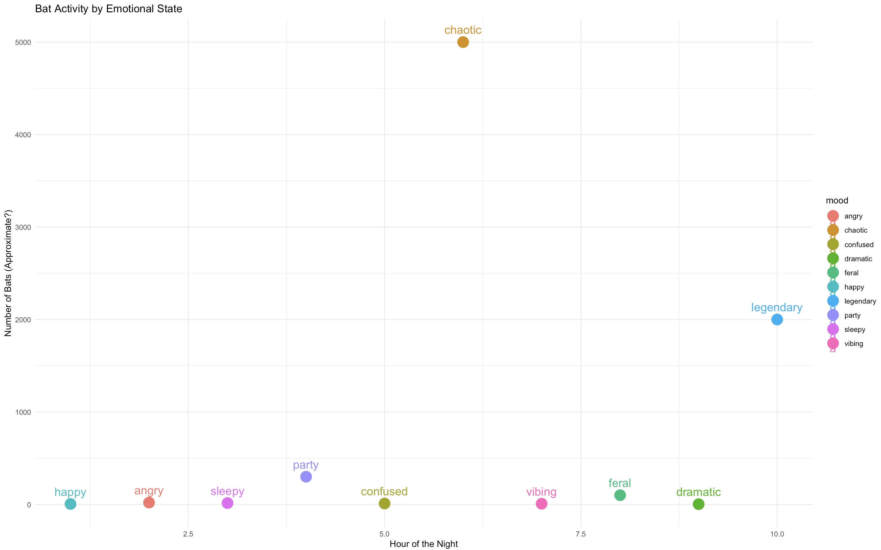
#5
Notes:
WINNER (Ayesha)

Slide 10
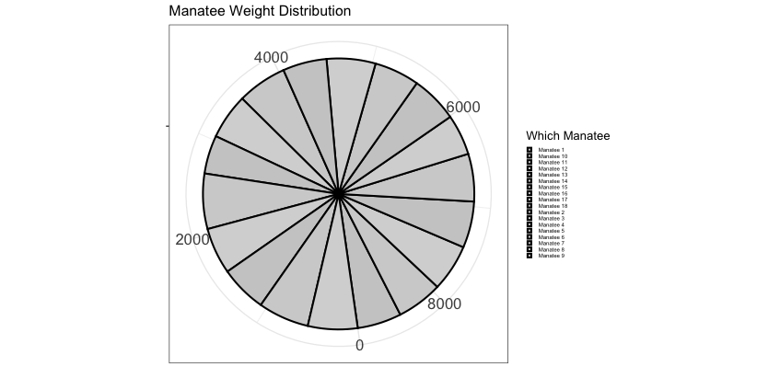
#6

Slide 11
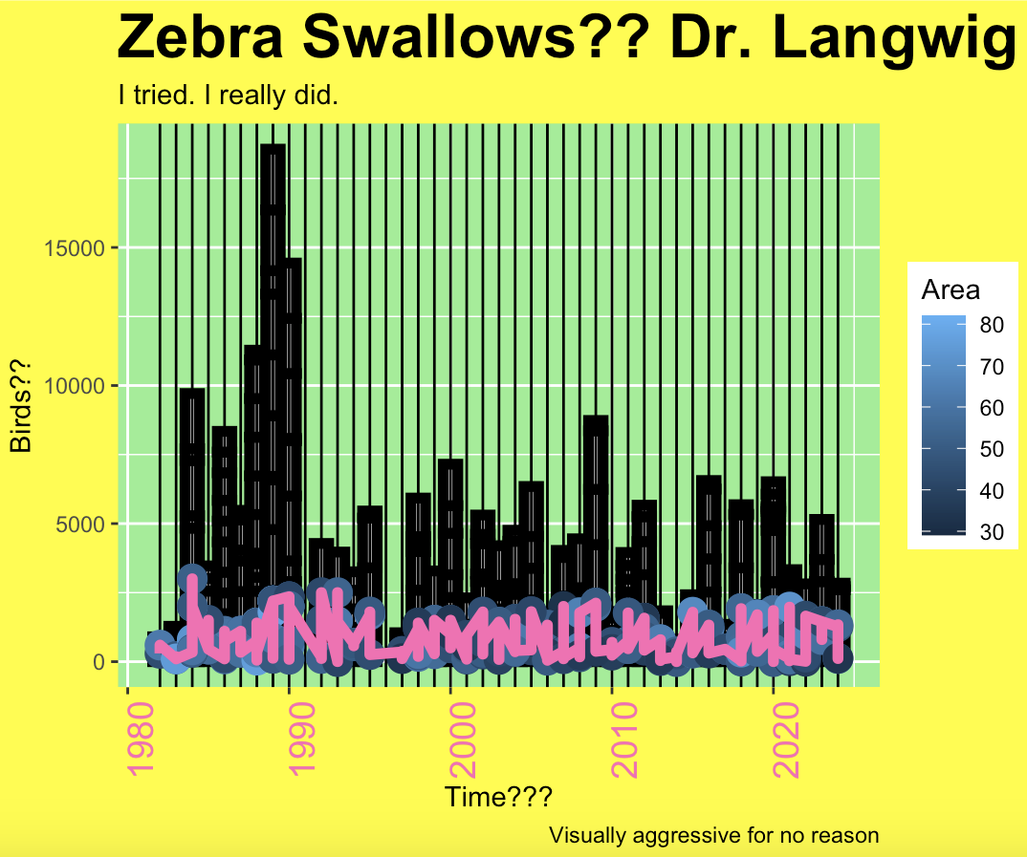
#7

Slide 12
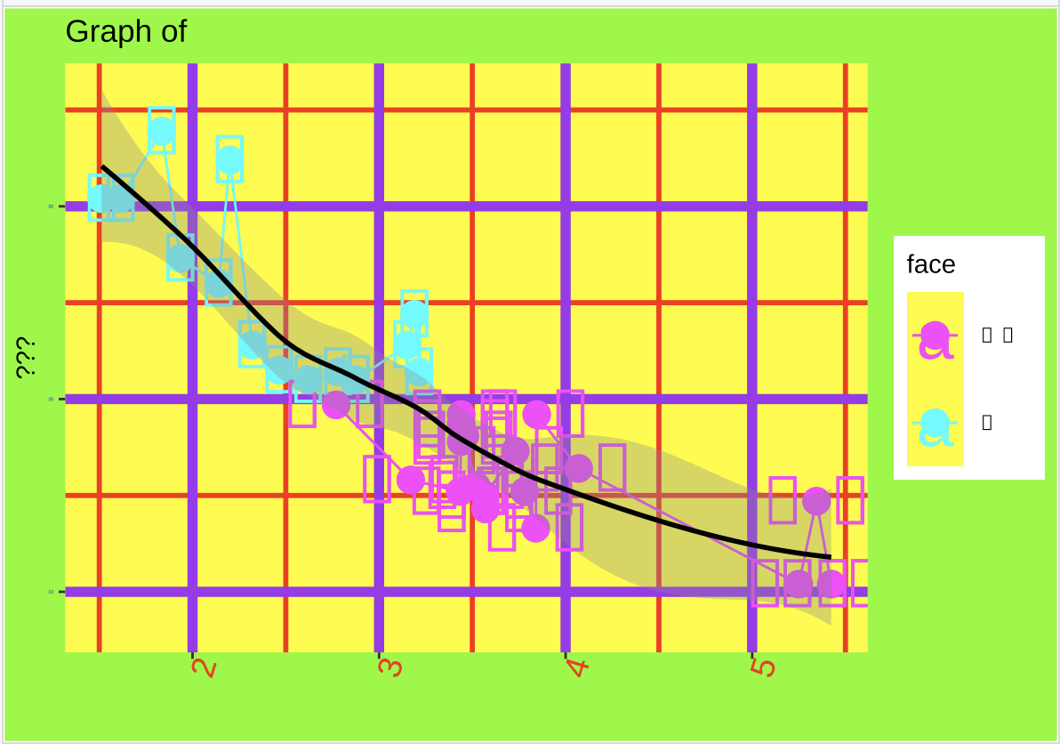
#8

Slide 13
One from my grad students…

Slide 14
(Mine – don’t vote!)

Slide 15
Vote at: PollEv.com/katelangwig411

